Slide 2
Network Layer:
Logical Addressing

Slide 3
Addressing
In addition to physical address that identify individual devices, the internet requires an additional addressing convention :
An address that identifies the connection of a host to its network

Slide 4
Each internet address consists of 4 bytes (32 bits); defining 3 fields
Class type
Net id
Host id
These parts are of varying length , depending on the class of the address

Slide 5
IPv4 ADDRESSES
An IPv4 address is a 32-bit address that uniquely and universally defines the connection of a device (for example, a computer or a router) to the Internet.

Slide 6

Note
An IPv4 address is 32 bits long.

Slide 7
Note
The IPv4 addresses are unique and universal.

Slide 8
Note
The address space of IPv4 is 2³² or 4,294,967,296.

Slide 9
Classes
5 different field-length patterns are in use, each defining a class of address
For ex,
Class A addresses are numerically the lowest
They use only 1-byte to identify class type and NetId, and leave 3-bytes available for HostId numbers
This means Class A networks can accommodate far more hosts than Class B or class c networks, which provide 2 and 1 byte hosted fields respectively.

Slide 10
Class D is reserved for multicast addresses.
Multicasting allows copies of a datagram to be passed to a select group of hosts rather that to an individual host.
It is similar to broadcasting, where a packet is passes to all possible destinations .
However, multicasting allows transmissions to a selected subset
Class E addresses are reserved for future use.

Slide 11
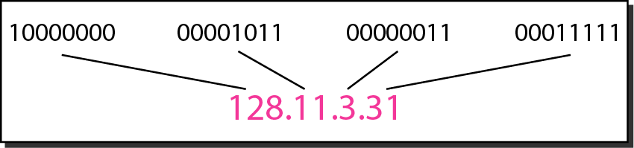
Dotted-decimal notation and binary notation for an IPv4 address

Slide 12
Let’s Solve
Change the following IPv4 addresses from binary notation to dotted-decimal notation.

Slide 13
Solution
We replace each group of 8 bits with its equivalent decimal number and add dots for separation.

Slide 14
Change the following IPv4 addresses from dotted-decimal notation to binary notation.

Slide 15
Solution
We replace each decimal number with its binary equivalent

Slide 16
Find the error, if any, in the following IPv4 addresses.

Slide 17
Solution
There must be no leading zero (045).
b. There can be no more than four numbers.
c. Each number needs to be less than or equal to 255.
d. A mixture of binary notation and dotted-decimal notation is not allowed.

Slide 18
Note
In classful addressing, the address space is divided into five classes:
A, B, C, D, and E.

Slide 19
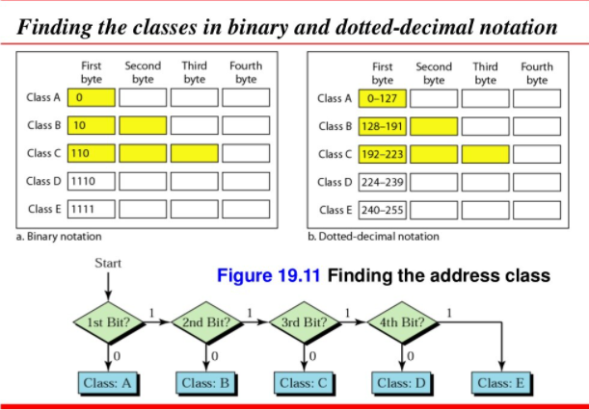

Slide 20
Find the class of each address.
a. 00000001 00001011 00001011 11101111
b. 11000001 10000011 00011011 11111111
c. 14.23.120.8
d. 252.5.15.111

Slide 21
Solution
a. The first bit is 0. This is a class A address.
b. The first 2 bits are 1; the third bit is 0. This is a class C address.
c. The first byte is 14; the class is A.
d. The first byte is 252; the class is E.

Slide 22
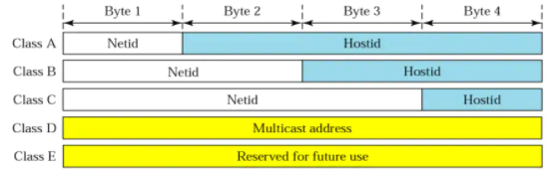
NetId and HostId
Find the netid and the hosted for each address :
4.23.145.90
227.34.78.7
246.7.3.8
129.6.8.4
198.76.9.23

Slide 23
4.23.145.90
Class A; Netid : 4 Hostid : 23.145.90
227.34.78.7
Class D, no Hostid or Netid
c. 246.7.3.8
Class E, no Hostid or Netid
d. 129.6.8.4
Class B Netid : 129.6 Hostid : 8.4
e. 198.76.9.23
Class C Netid : 198.76.9 Hostid : 23

Slide 24
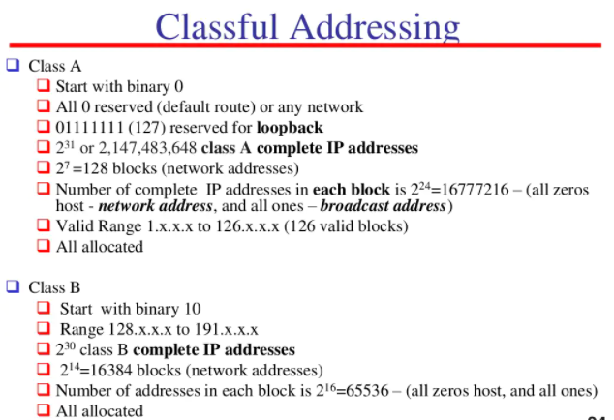

Slide 25
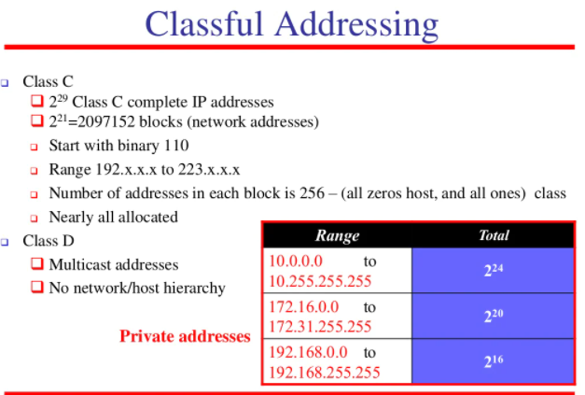

Slide 26
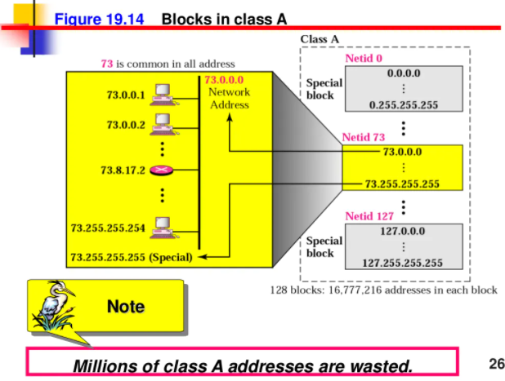

Slide 27
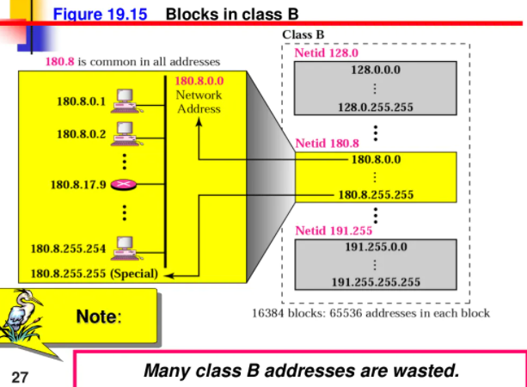

Slide 28
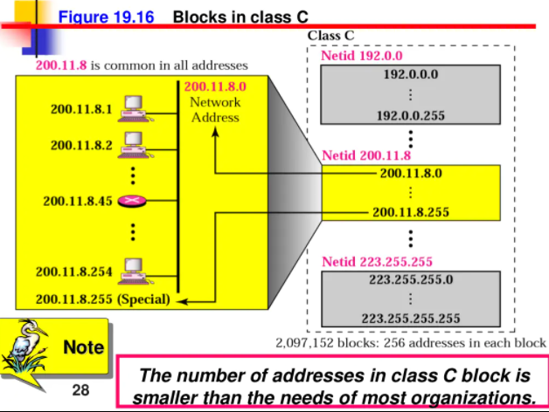

Slide 29
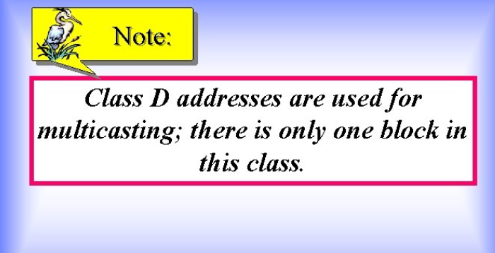

Slide 30
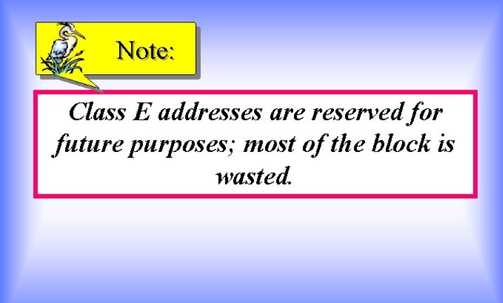

Slide 31
Number of blocks and block size in classful IPv4 addressing

Slide 32
Note
In classful addressing, a large part of the available addresses were wasted.

Slide 33
Network Addresses
Play a significant role in classful addressing
It is the first address in the block
It defines the network to the rest of the internet.
Router routes a packet based on the network address
Given the network address, we can find the class of the address, the block, and the range of the addresses in the block

Slide 34
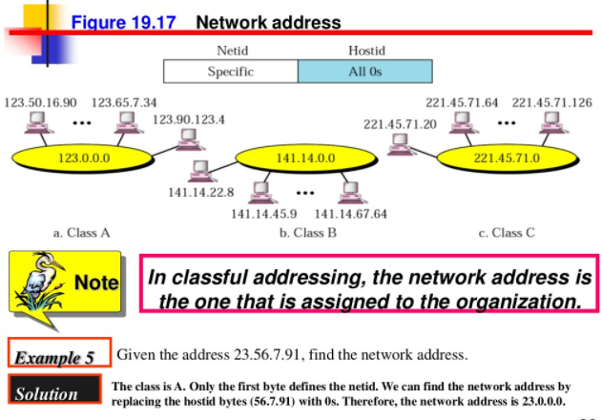

Slide 35
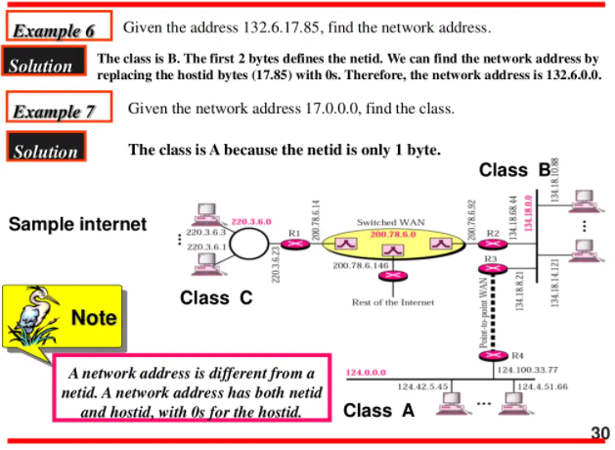

Slide 36


Slide 37
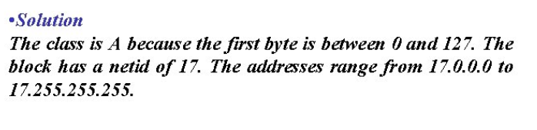

Slide 38
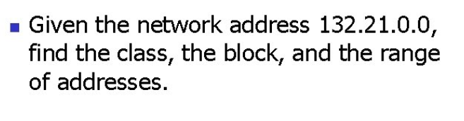

Slide 39
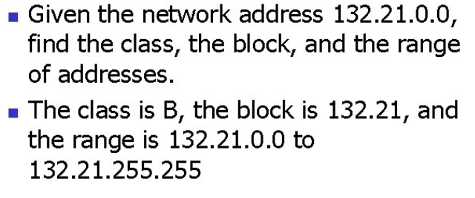

Slide 40
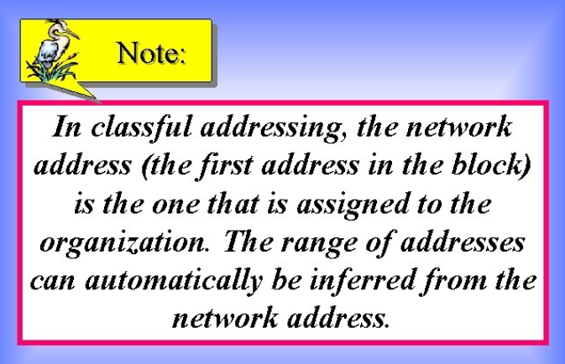

Slide 41
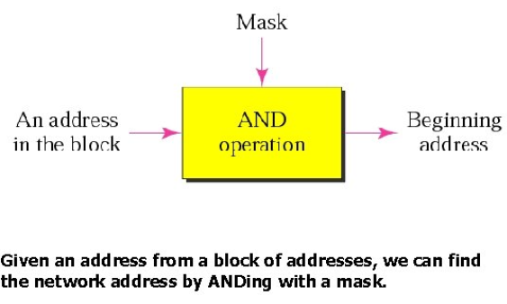
Mask
A mask is a 32-bit number that gives the first address in the block (the network address) when bitwise ANDed with an address in the block.

Slide 42
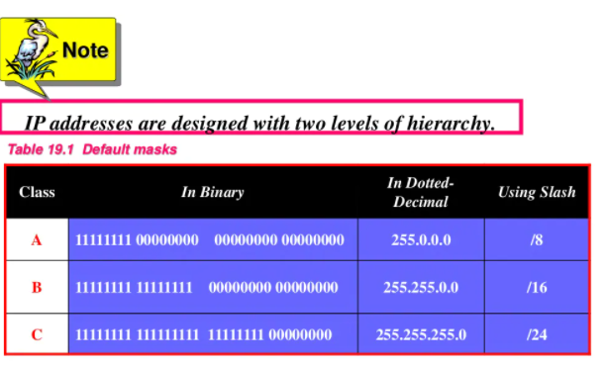

Slide 43
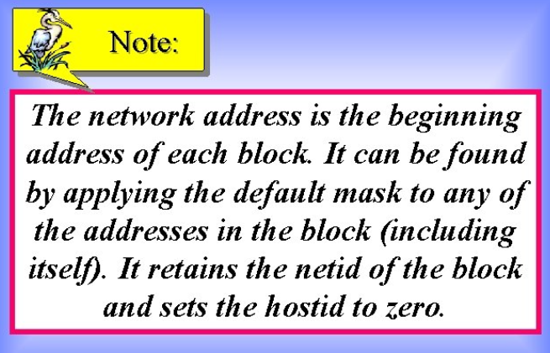

Slide 44
Applying the masks
Applying mask to an unsubnetted network is simple
Two rules can help find the network address without applying the AND operation
If the mask byte is 255, retain the corresponding byte in the address
If the mast byte is 0, set the corresponding byte to 0

Slide 45
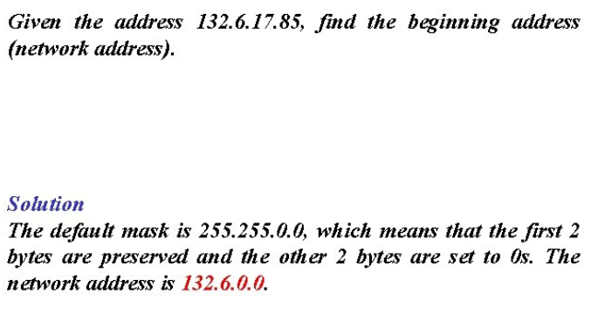

Slide 46
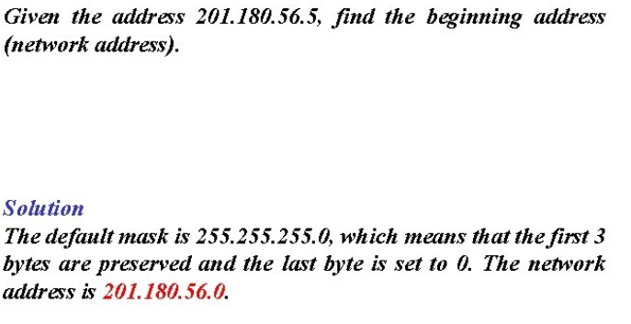

Slide 47
Note :
Note that we must not apply the default mask of one class to an address belonging to another class

Slide 48
CIDR Notation
The CIDR or classless inter domain routing, is used to explicitly indicate the default mask
In this notation, the number of 1s in the mask is added after a slash at the end of the address
For example, the address 18.46.74.10 which is class A address with the mask 255.0.0.0 is written as 18.46.74.10/8 to show that there are eight 1s in the mask.

Slide 49
Similarly, the address 141.24.74.69 which is class B address with the mask 255.255.0.0 is written as 141.24.74.69/16 to show that there are sixteen 1s in the mask.
In the same way, the address 200.14.70.22 is written as 200.14.70.22/24
CIDR notation is particularly useful in classless addressing

Slide 50
Address Depletion
Due to the classful addressing scheme and due to fast growth of internet, the available addresses are almost depleted.
We have run out of class A and B addresses, and a class C block is too small for most middle-size organizations
Solution is Subnetting and Supernetting

Slide 51
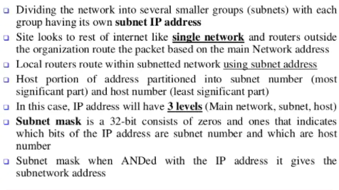
Subnetting

Slide 52
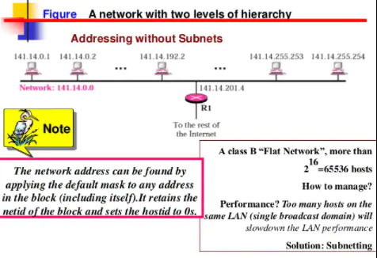

Slide 53
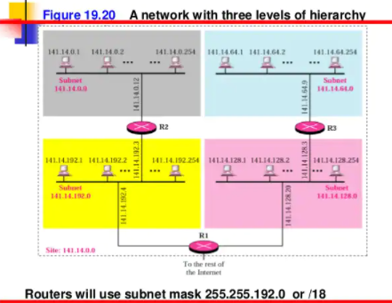

Slide 54
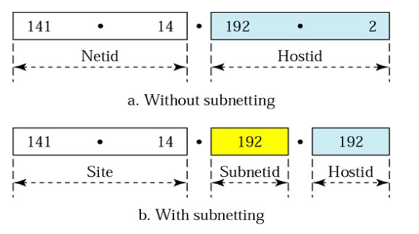
Addresses in a network with and without subnetting

Slide 55
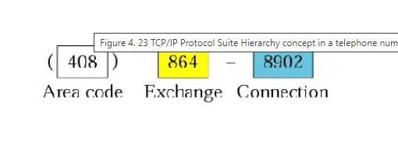
Hierarchy concept in telephone number

Slide 56
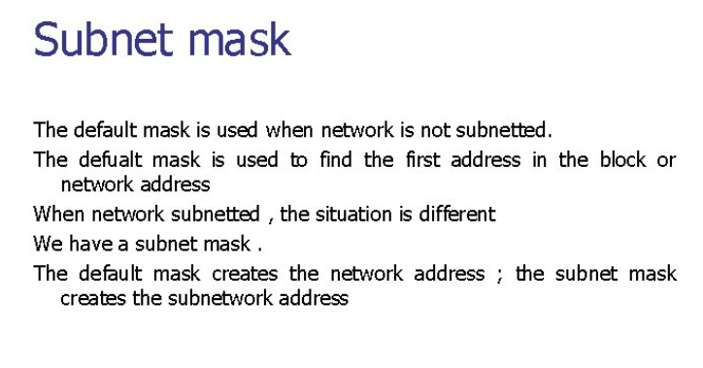

Slide 57
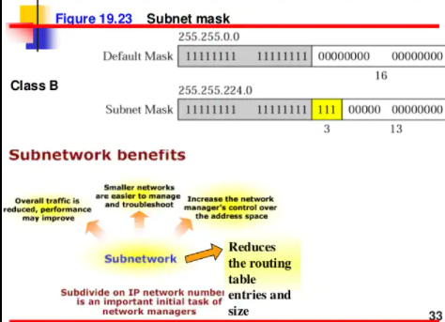

Slide 58
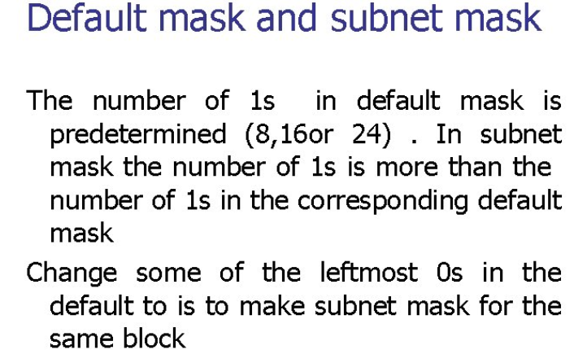

Slide 59
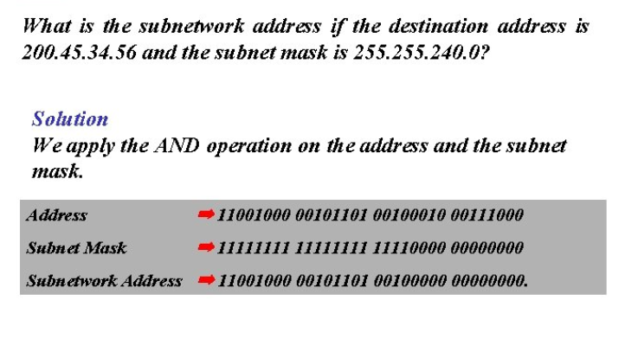
The subnetwork address is 200.45.32.0

Slide 60
Number of Subnetworks
The number of subnetworks can be found by counting the extra 1s that are added to the default mask to make the subnet mask
For Ex: The no of extra 1s is 3; therefore the number of subnets is (2³ ⁼ 8).

Slide 61
Number of addresses per subnet
The number of addresses per subnetwork can be found by counting the number of 0s in the subnet mask
For ex: the number of 0s is 13; therefore the number of possible addresses in each subnet is 2¹³ ⁼ 8192.

Slide 62
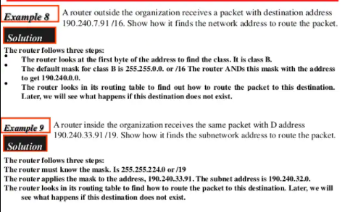

Slide 63
Supernetting
Class A and B addresses are getting depleted
Class C addresses are still available
However, the size of a class C block with a mx number of 256 addresses may not satisfy the needs of an organization
Even a mid size organization may need more addresses
One solution is Supernetting

Slide 64
Contd…
In supernetting, an organization can combine several class C blocks to create a large range of addresses
For Ex : An organization that needs 1000 addresses can be granted four class C blocks.
The organization can then use these addresses in one super network as shown

Slide 65
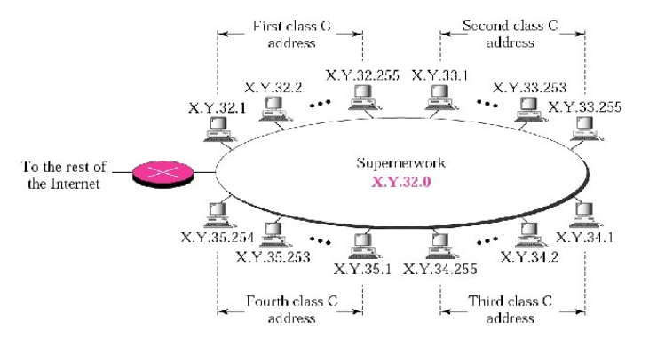
A Supernetwork

Slide 66
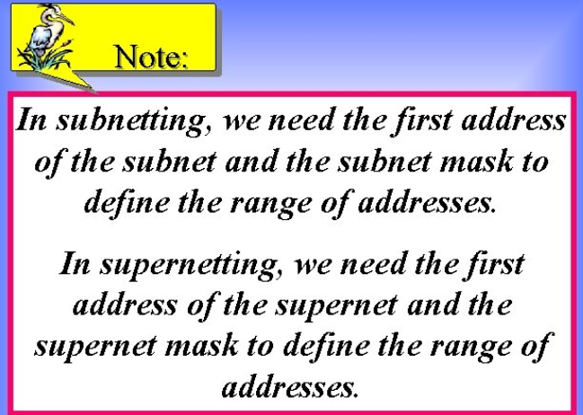

Slide 67
Subnet vs Supernet mask
A subnet mask that divides a block into 8 sub blocks has three more 1s (2³⁼ 8) than the default mask;
A supernet mask that combines eight blocks into one superblock has three less 1s than the default mask

Slide 68
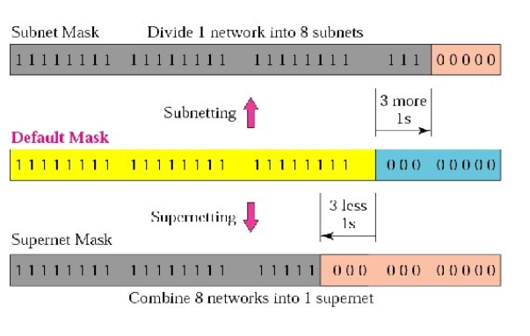
Comparison of subnet, default, and supernet mask

Slide 69
CIDR notation
This notation can also be used when we have supernets
For eg: the notation 141.14.192.3/24 shows a class C address, but the address
141.14.192.3/21 shows that the address
belongs to the supernet with the mask
255.255.248.0

Slide 70
Note
Classful addressing, which is almost obsolete, is replaced with classless addressing.

